Slide 1
AUTOMATIC PILL DISPENSER
BY
TEAM 404
Team members
Esther Maria
Gaadha Jeevan
Iham Mohammed
Mentor - Chelsa Mariam
EBE3 | Model Engineering College

Slide 2
INTRODUCTION
Fascinatingly the study on medical errors and accidents that happens frequently involves medication errors and adverse drug reactions.
The intake of numerous medications for old patients as well as the accompanying specifications of each medication does increase the risk of major accidents that can cost life.
Considering these reasons the importance of an automated system for dispensing medication is crucial and is the need of the hour .
Administrative errors account for about 30-40% of all the errors that can be prevented.
The dispenser is designed to eliminate the misunderstanding of medication directions and inconvenience of rigid medication schedules.

Slide 3
COMPONENTS

Slide 4
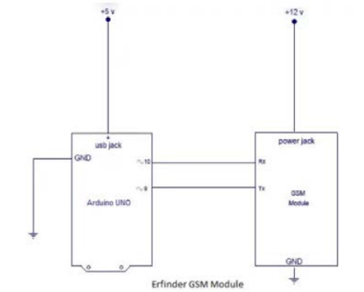
ALERT MODULE
The alert module is a combination of a GSM
sim 900 module which has a sim card
mounted. This enables us to alert the patient
via text SMS.

Slide 5
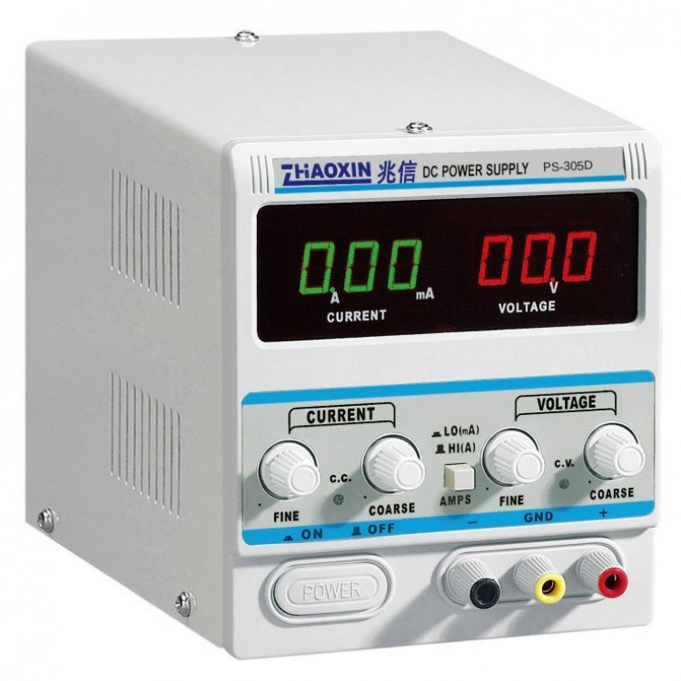
POWER SUPPLY
The alert module is a combination of a GSM sim900 module which has a sim card mounted. This enables us to alert the patient via text SMS.

Slide 6
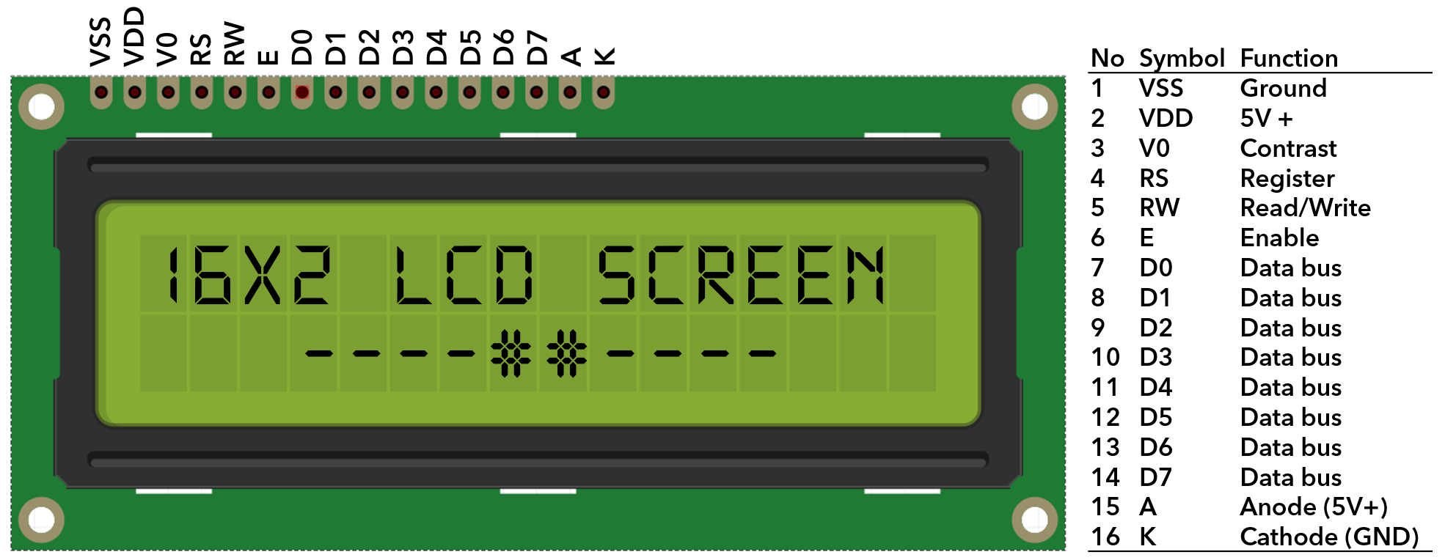
LCD DISPLAY
The 16x2 display used is a basic display device that finds various applications over the 7 segment display. It can display 16 characters over 2 lines and each character is displayed in a 5x7 pixel matrix. The module works with 2 basic registers command and data.

Slide 7
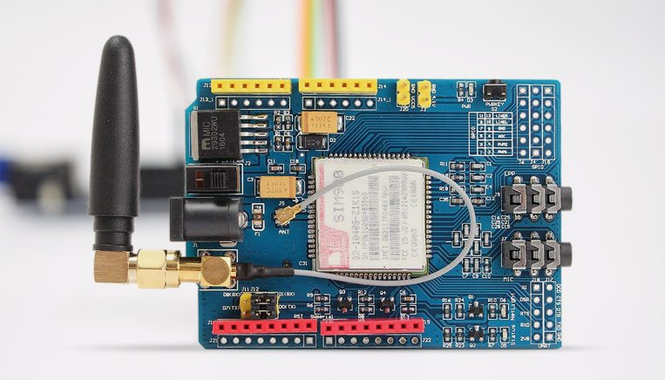
GSM 900 MODULE
A GSM module works on various frequencies. GSM 900 works with a quad-band frequency of 900MHz. It can not only be used to access the internet but also for oral communication. The module is managed by AMR926EJ-S processor which controls phone and data communication

Slide 8
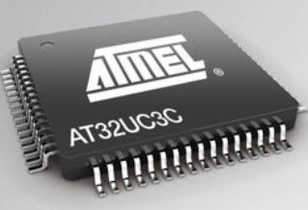
MICROCONTROLLER
Amongst the various microcontrollers available in the market to control a device, Arduino is an open source hardware and software company that provides microcontrollers which can sense and control objects or components in real world.It consists of Atmel 8 bit microcontroller with different availability of flash RAM.The open source nature allows the publication of various free software libraries.Here the Arduino is used to control the functioning of GSM 900, Servo, LCD display, RTC module and the ultrasonic sensor.

Slide 9
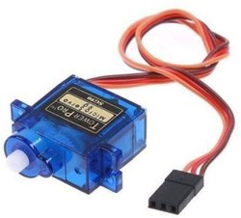
SERVO
A servo is a device that aids in rotatory motion with precise angle, acceleration and velocity through a motor coupled to a sensor with feedback.The angle that the shaft of the servo moves to can be controlled through Arduino in terms of degree it rotates to. In this area servo finds application to rotate the medicine box with a hole at the top to dispense the medicines stored in the box by rotating at different angles varying with the medicine to be dispensed.

Slide 10
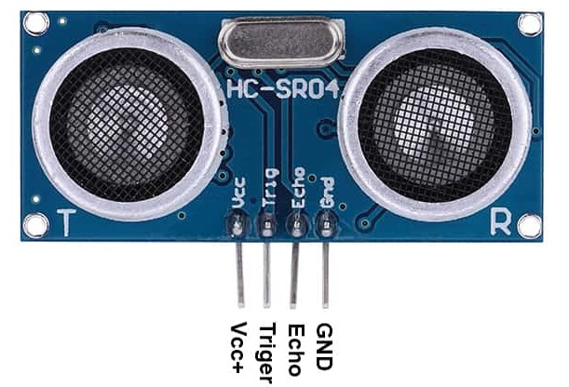
ULTRASONIC CONTROLLER
An ultrasonic sensor is used to measure the distance between an object through ultrasonic waves. The sensor emits ultrasonic waves and receives the reflected waves from the object. The distance between the objects is measured through the time taken to receive the waves after emission.

Slide 11
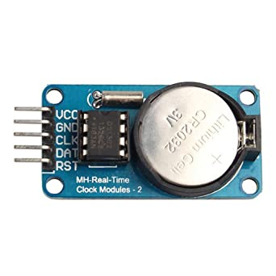
RTC MODULE
An RTC module is a real time clock. It is based on DS1307 i.e. it is a lower power consumer, full binary-coded decimal (BCD) clock with 56B of NV RAM it follows I2C and bidirectional bus protocol for transmission of address and data. The clock/calendar is automatically adjusted for a month less than 31 days but needs to be reset for months with 31 days. It works in 12 or 24hr format in AM/PM format. The DS1307 has a built-in power-sense circuit that detects power failures and automatically switches to the backup supply.The basic idea to use the RTC module in this application is to sync the system to real time to send a message to the user at the exact time when his medicine is due.

Slide 12
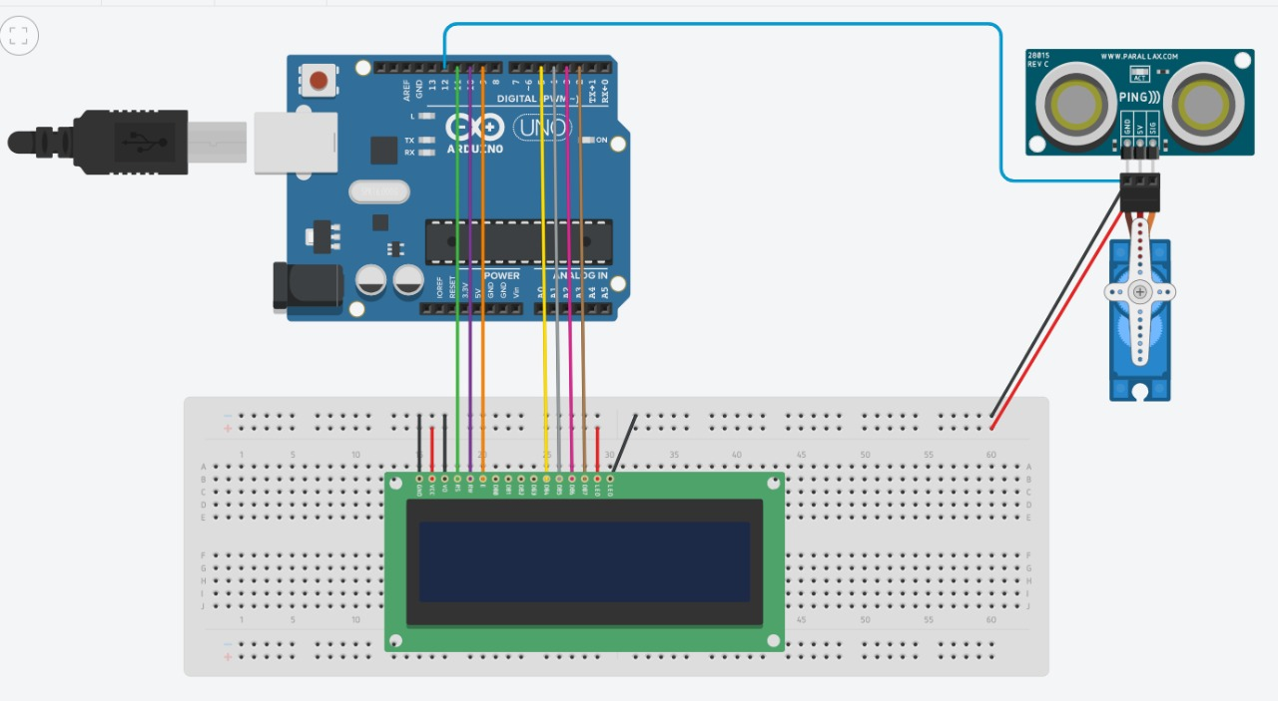
CIRCUIT DIAGRAM

Slide 13
WORKING
Pill dispenser involves the use of an ultrasonic sensor depending on which the dispenser dispenses pills to the patient.
The sensor is active for a certain period of time after the alert message has been sent to the user.
The dispenser keeps a track of the amount of pills left in stock and displays it on an LCD.
This is governed by initially setting the number of pills placed in the dispenser and at each activation period.

Slide 14
FEATURES
Ensures the timely intake of medication with the help of remainder
Notifies both the sick and the caretaker
Keeps the track of missed pills
Reminds the patient about the days needed to be taken and the days already taken
Gives warning when the pill is about to run out as well as expire.
Avoids confusion regarding the administration of medications
Reminds about other required specifications that need to considered while the intake of pills.

Slide 15
WHY THIS PRODUCT ?
User friendly - the dispenser comprises of very simple working and there is almost nil scope for confusion
Cost effective- Arduino is a simple open source hardware and software that provides us the microcontroller.
Portable
Avoids confusion when have to take large no of pills
Avoid medical accidents
Makes it easier for the caretakers
Nullify misunderstandings while taking medications

Slide 16
FUTURE SCOPE
The dispenser is a stand- alone tool, and is capable of adjusting the schedule as per the requirements of the patient or a change in prescriptions.
The dispenser is designed for individuals who do not need constant monitoring and supervision but instead need a device to track their pill cycle during the course of the day.
The device is a supplement for all the reminders on paper or our mobile phones that constantly nag the user with notifications, not just the notifications the user is now free from keeping a track of all his pill refill, instead the device keeps a track for the user and reminds him when refill is required.

Slide 17
CONCLUSION
The pill dispenser provides a means of regular medication at regular time intervals.
The dispenser makes sure that the user is alerted every time he/she needs to take a dose, this way the patient and the caretaker need not worry about setting reminders for his/her daily medicine schedule.
Moreover, the automated system makes sure that the right amount of dosage is being consumed by the user and this rules out the possibility of over and under dosage.

Slide 18
RESEARCH RESOURCES
1.https://circuitdigest.com/microcontroller-projects/arduino-medicine-reminder
2.https://drive.google.com/file/d/1I_3BCwreQVIGZtWhk9UhjRF6Bl1A51xA/view?usp=sharing
3.https://drive.google.com/file/d/1qkrI5Qqu5uAsqDL8hyvZhslkoJXy0POi/view?usp=sharing

Slide 19
THANK YOU

